Slide 1
Database Design: Normalisation
Week / Session 05
Maryam Shahabi Lotfabadi
Adrian Gould
Namrata Aneja
ICT40518 Certificate IV in Programming
Data Driven Applications
ICTPRG402 | Apply Query Language
ICTPRG403 | Develop Data Driven Applications

Slide 2
Databases Review
Relational Databases & Database Design

Slide 3
Review – Databases
Item | Recap
Database Management System (DBMS) | A system that permits the access, and use of a collection of databases. Examples: MySQL, MariaDB, MongoDB, PostgreSQL, Oracle
Database (DB) | A collection of one or more tables
Table | Collection of rows of data. Examples: people, users, sets, games, game players
Field / Column / Attribute | A single item of data. Examples: given name, game id, date of birth, temperature
Record / Row | A collection of closely related data. Examples: “Jacques”, “d’Carre”, 1.92
Data | Values that have not had context provided to it. Examples: 1.83, -3.7, Fred, 2021
Information | Is data that has a context (meaning) applied to it. Examples: Height: 1.83m, Min Temp: -3.7ºC, Name: Fred, Year: 2021

Slide 4
Database Tables
Relational Databases & Database Design

Slide 5
Create 2 database tables with the primary key
Most common is the Entity-Relationship Diagram (ERD)
Uses lines to join tables
Indicate “number of times” using
Crows feet
Values

Slide 6
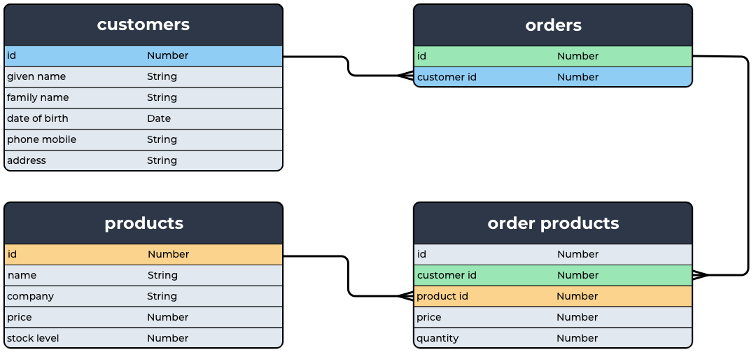
ERD: Crows Feet
Notes:
ERD diagram stands for Entity and Relationship Diagram where customers table, order Table and product table are Entities whereas line connecting them is showing Relationship
1:M relationship between customers and orders
1:M relationship between Products and order products
1:M relationship between orders and order products

Slide 7



Diagrams for Database Design
E-R Diagrams
Crows feet
1 to 1
1 to many
Many to many

Slide 8



Diagrams for Database Design
E-R Diagrams
Value indicators
1 to 1
1 to many
Many to many

Slide 9
Gathering Data
Relational Databases & Database Design
Notes:
Gathering samlke data is VITAL for good database design

Slide 10
Collect Data
What do we need?
General information on the business
Specific information on purpose of database
Processes the database is to be used for
Sample forms used in the processes
Samples of reports generated
Sample data
Notes:
We gather data in different businesses and gather in form of tables and we call it in normalization terminology as Zero Normalized Form or 0NF

Slide 11
Sample Data
Sample data may be in the form of:
Reports
Current database data
Forms
Spreadsheets
And many more sources

Slide 12
Sample Data
Once the data is collected
Look over it carefully
Identify data that is REQUIRED for the application
Notes:
Once we collect data then before we use it in any application we make sure that it is Normalized and can fit into the SQL standards

Slide 13
To use sample data according to SQL requirements can be called as Normalization
•Formal process
•Reduces redundancy
•Resulting in (usually) more efficient databases
•May add fields or whole tables

Slide 14
Normalisation
Relational Databases & Database Design

Slide 15
Normalisation
Why we need Normalization of a Data base?
•Once the data is collected,Look over it carefully.
•Identify data that is REQUIRED for the application
•The raw data can’t be used straight away in the application It might have many anomalies.
•
Notes:
Normalisation is a formal process to structure a database in such a way that optimises the database and reduces data redundancy (that is, repeated data).
Normalised databases are generally more efficient to run than those which are not - a very important consideration when dealing with large databases.
The process may involve adding fields or even whole tables, and comes in three steps.

Slide 16
Normalisation
We need Normalized Tables of data base because as we keep on inserting data records in the table it sometimes causes anomalies.
To avoid those anomalies, It is good to keep the Data base in a Normalized form. In other words, Normalization is an easy way to keep data in organized tables.
Notes:
Normalisation is a formal process to structure a database in such a way that optimises the database and reduces data redundancy (that is, repeated data).
Normalised databases are generally more efficient to run than those which are not - a very important consideration when dealing with large databases.
The process may involve adding fields or even whole tables, and comes in three steps.

Slide 17
Why Normalization?
•The table with raw data or with anomalies is considered as 0NF (Zero Normalized Form).
Normalization helps in removing those anomalies
•We can remove those anomalies with the help of certain rules .
These rules are called as
•First Normalised Form or 1NF
•Second Normalised Form or 2NF
•Third Normalised Form or 3NF
••
•Each normal form has certain rules

Slide 18
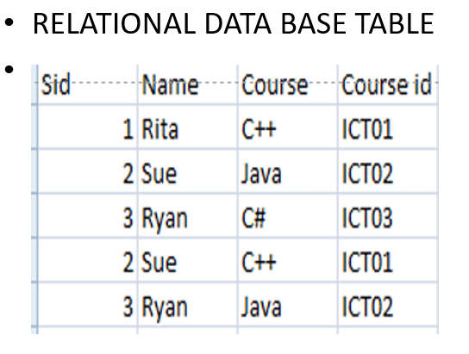
Let's know what kind of anomalies are possible in data base
When we are adding data records in this tables. The following questions may pop-up in our minds
Is one table enough?
Do I need two tables?
How do I divide this table?

Slide 19
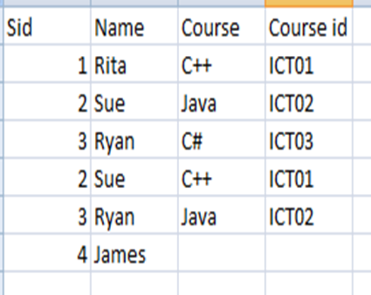
Storing data may cause some anomalies 1.Data anomaly while Insertion
Data anomaly while Insertion is the inability to add data to the database due to the absence of some other data.
For e.g. We know there is the student James but do not know his Course Name and Course Id. Hence, One can not add his record.

Slide 20
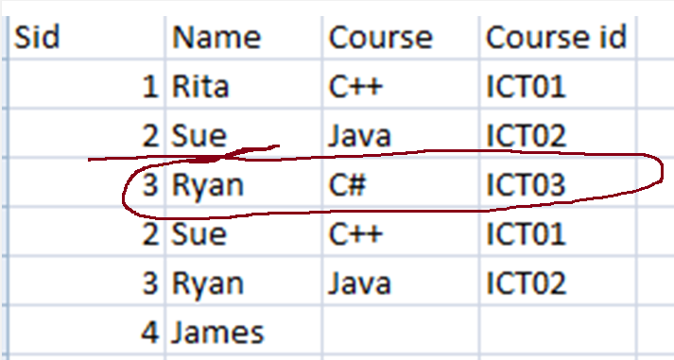
2.Deletion Anomaly
Ryan has left the school and his record must be deleted, Oops, we are deleting course information for C# and ICT03 too

Slide 21
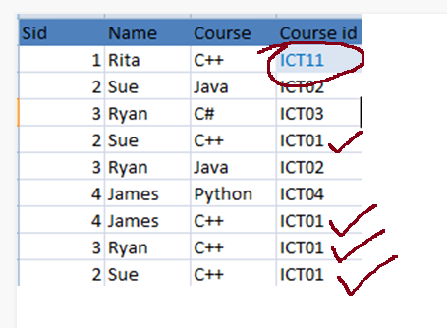
3.Updation Anomaly
For example, C++ has the Course Id-ICT01. If the course id has changed to ICT11,thus it should be visible in all the records. If not, then it is an update anomaly.

Slide 22
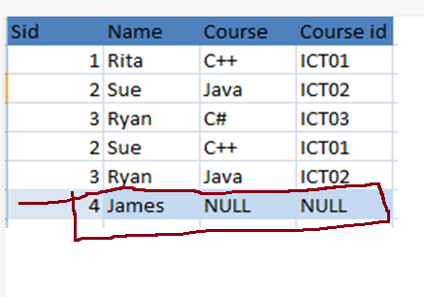
The Solution to above insertion anomaly is here
How to avoid Anomalies in INSERTION – place a NULL value.
We can add the new student James and if we do not know his Course Nmae or Course Id then we can add NULL and add the record.

Slide 23
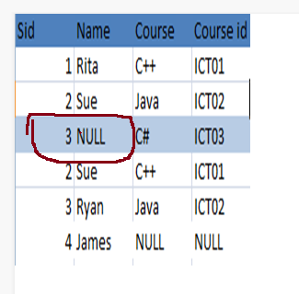
The Solution to Deletion anomaly is here
Avoid Deletion Anomaly by placing Null value
•If Ryan is leaving the school we can remove his name by placing Null and we do not loose any of the information.

Slide 24
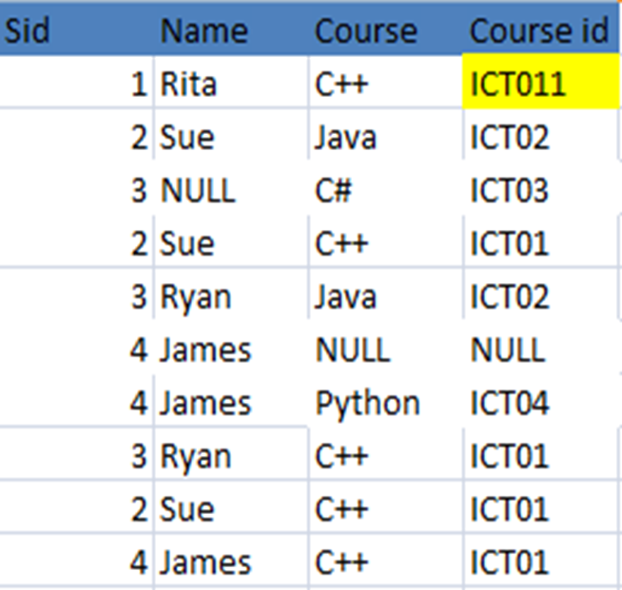
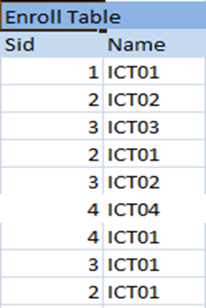
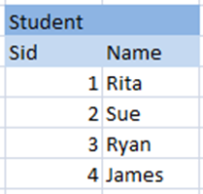
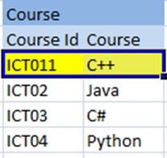
Solution to update Anomaly
If we need to update course Id from ICT01 to ICT11. We store the information in different tables and update easily.

Slide 25
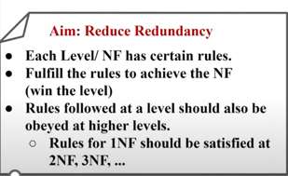
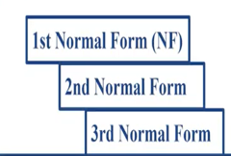
Normalization is an effective method of organizing data using relational Tables
The objective is to reduce redundancy and we do it at different levels. These levels are called as

Slide 26
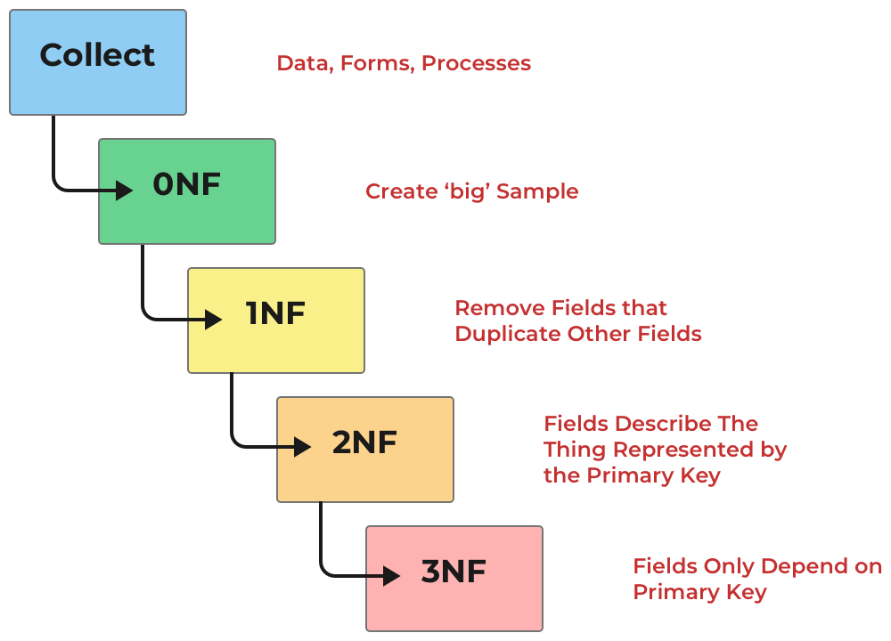
Database Design: Normalisation
Normalisation: Explanation and Example

Slide 27
Normalisation
Formal process
Reduces redundancy
Resulting in (usually) more efficient databases
May add fields or whole tables
Notes:
Normalisation is a formal process to structure a database in such a way that optimises the database and reduces data redundancy (that is, repeated data).
Normalised databases are generally more efficient to run than those which are not - a very important consideration when dealing with large databases.
The process may involve adding fields or even whole tables, and comes in three steps.

Slide 28
Normalisation
We will show the process using an Orders Database

Slide 29
Normalisation: Collect Data
Relational Databases & Database Design

Slide 30
Collect Data-we collect data from different businesses/platforms and put them in form of table,such a table with raw data is in 0(zero) Normalized Form
To create a 0NF table,What do we need?
General information on the business
Specific information on purpose of database
Processes the database is to be used for
Sample forms used in the processes
Samples of reports generated
Sample data

Slide 31
Collect Data
General information on the business
Obtain from the Internet and Business Registries
Talk to the client
May provide information that may not be in samples

Slide 32
Collect Data
Specific information on purpose of database
What is the database for?
Why do they need it?
What resources they need?

Slide 33
Collect Data
Processes the database is to be used for
Determines the data flow
Determines key points in data requirements

Slide 34
Collect Data
Processes the database is to be used for
Determines the data flow
Determines key points in data requirements

Slide 35
Collect Data
Samples of reports generated
Give generated results
Provides insights into how data to be manipulated
May give further data that needs collecting

Slide 36
Collect Data
Sample data
This is the key!
Sample data is exceptionally important
Provides the remaining base details

Slide 37
Collect Data
We presume that we have:
General Information on Business
Collected Sample Data
Collected Sample Forms
Collected Details of Current Processes

Slide 38
Normalisation: 0NF Zero Normal Form
Relational Databases & Database Design

Slide 39
0NF
The raw data is seen as 0NF or Zero Normal Form
It is un-normalized data.
Here is table with the raw data

Slide 40
0NF
Sample data: Orders
Order | Date | Cust no | Cust name | Postcode | Address | Item code | Description | Category | Price | Qty
A100 | 26/04/15 | B236 | Vincent Hong | 6276 | 14 High St, Crawley, WA, AU | 089-095 | Ultra slim DVD player | DVD | $39.00 | 1
 |  |  |  |  |  | 540-502 | Spiked trackshoe | Shoes | $59.95 | 1
A200 | 26/04/15 | C341 | Jo Alva | 2027 | 101 Peter’s Lane, Wooloomaloo, NSW, AU | 001-405 | Tektonics laptop | Comp | $1,095.00 | 1
 |  |  |  |  |  | 986-868 | Skussi watch | Jewellery | $19.99 | 2
A300 | 27/04/15 | B451 | Cheryl Smith | OX12 3GH | 12 Hallwood Rd, Oxford, UK | 041-907 | Funtio mobile phone | Phones | $50.00 | 1
A400 | 28/04/15 | D847 | Mandeep Patel | 14699 | 67 Widney St, Saint John, ID, USA | 089-096 | DVD recorder | DVD | $895.00 | 1
 |  |  |  |  |  | 678-943 | Flat screen TV | TV | $289.00 | 1
 |  |  |  |  |  | 543-908 | TV stand | TV | $69.00 | 1
Notes:
In this sample data we do not have a products being purchased by more than one person…
Keep this in mind, as most ordering systems WILL have products purchased by more than one person.

Slide 41
Normalisation: 1NF First Normal Form
Relational Databases & Database Design

Slide 42
1NF
Rules:
There are no repeating groups
All data values are atomic (cannot be divided up into related components)
Each field has a unique name
There is a primary key (using one or more fields)

Slide 43
1NF: Orders
Order | Date | Customer Number | Customer Given name | Customer Last Name | Address | Town | State | Postcode | Country
A100 | 26/04/2015 | B236 | Vincent | Hong | 14 High St | Crawley | WA | 6276 | AU
A200 | 26/04/2015 | C341 | Jo | Alva | 101 Peter’s Lane | Wooloomaloo | NSW | 2027 | AU
A300 | 27/04/2015 | B451 | Cheryl | Smith | 12 Hallwood Rd | Oxford | Oxon | OX12 3GH | UK
A400 | 28/04/2015 | D847 | Mandeep | Patel | 67 Widney St | Saint John | ID | 14699 | USA

Slide 44
1NF: Order - Products
Order * | Item code | Description | Category | Price | Qty
A100 | 089-095 | Ultra slim DVD player | DVD | $39.00 | 1
A200 | 001-405 | Tektonics laptop | Comp | $1,095.00 | 1
A300 | 041-907 | Funtio mobile phone | Phones | $50.00 | 1
A400 | 089-096 | DVD recorder | DVD | $895.00 | 1
A100 | 540-502 | Spiked trackshoe | Shoes | $59.95 | 1
A200 | 986-868 | Skussi watch | Jewellery | $19.99 | 2
A400 | 678-943 | Flat screen TV | TV | $289.00 | 1
A400 | 543-908 | TV stand | TV | $69.00 | 1

Slide 45
1NF
We can say that we have:
2 tables with the names Orders and Order –Products in 1NF.
Both of them do not have any repeated values.
Both of the tables have only atomic values.
Each field has unique name
Each table has got a primary key.

Slide 46
Normalisation: 2NF Second Normal Form
Relational Databases & Database Design

Slide 47
2NF
Rules:
It is in 1NF
All non key attributes depend on ALL PARTS of the primary key
Each field has a unique name
There is a primary key (using one or more fields)

Slide 48
2NF: Customers
Customer Number | Customer Given name | Customer Last Name | Address | Town | State | Postcode | Country
B236 | Vincent | Hong | 14 High St | Crawley | WA | 6276 | AU
C341 | Jo | Alva | 101 Peter’s Lane | Wooloomaloo | NSW | 2027 | AU
B451 | Cheryl | Smith | 12 Hallwood Rd | Oxford | Oxon | OX12 3GH | UK
D847 | Mandeep | Patel | 67 Widney St | Saint John | ID | 14699 | USA

Slide 49
2NF: Orders
Order | Date | Customer Number
A100 | 26/04/2015 | B236
A200 | 26/04/2015 | C341
A300 | 27/04/2015 | B451
A400 | 28/04/2015 | D847

Slide 50
1NF: Products
Item code | Description | Category | Retail Price
089-095 | Ultra slim DVD player | DVD | $39.00
001-405 | Tektonics laptop | Comp | $1,095.00
041-907 | Funtio mobile phone | Phones | $50.00
089-096 | DVD recorder | DVD | $895.00
540-502 | Spiked trackshoe | Shoes | $59.95
986-868 | Skussi watch | Jewellery | $19.99
678-943 | Flat screen TV | TV | $289.00
543-908 | TV stand | TV | $69.00

Slide 51
2NF: Order - Products
Order * | Item code | Price Sold At | Qty
A100 | 089-095 | $39.00 | 1
A200 | 001-405 | $1,095.00 | 1
A300 | 041-907 | $50.00 | 1
A400 | 089-096 | $895.00 | 1
A100 | 540-502 | $59.95 | 1
A200 | 986-868 | $19.99 | 2
A400 | 678-943 | $289.00 | 1
A400 | 543-908 | $69.00 | 1

Slide 52
2NF Items
Item code ​ | Description ​ | Category ​ | Price ​ | Qty ​
089-095 ​ | Ultra slim DVD player ​ | DVD ​ | $39.00​ | 1​
001-405 ​ | Tektonics laptop ​ | Comp ​ | $1,095.00​ | 1​
041-907 ​ | Funtio mobile phone ​ | Phones ​ | $50.00​ | 1​
089-096 ​ | DVD recorder ​ | DVD ​ | $895.00​ | 1​
540-502 ​ | Spiked trackshoe ​ | Shoes ​ | $59.95​ | 1​
986-868 ​ | Skussi watch ​ | Jewellery ​ | $19.99​ | 2​
678-943 ​ | Flat screen TV ​ | TV ​ | $289.00​ | 1​
543-908 ​ | TV stand ​ | TV ​ | $69.00​ | 1​

Slide 53
2NF
We have put both the 1NF Orders and Order- Products tables
into the 2NF
Orders is divided into 2 tables Customers and Orders in 2NF
Order-Products and Items are in 2NF.

Slide 54
2NF
All the 4 tables Customers, Orders ,Items and Order-Products are in 2NF.
All the tables have a primary key and rest of the fields of the table are dependent on this primary key.
Each field name is unique

Slide 55
Normalisation: 3NF Third Normal Form
Relational Databases & Database Design

Slide 56
3NF
Rules:
It is in 2NF
All non key attributes DO NOT depend on any other non key attributes
Each field has a unique name
There is a primary key (using one or more fields)

Slide 57
We further divide Items table in 3NF
Item code ​ | Description ​ | Category ​ | Price ​ | Qty ​
089-095 ​ | Ultra slim DVD player ​ | DVD ​ | $39.00​ | 1​
001-405 ​ | Tektonics laptop ​ | Comp ​ | $1,095.00​ | 1​
041-907 ​ | Funtio mobile phone ​ | Phones ​ | $50.00​ | 1​
089-096 ​ | DVD recorder ​ | DVD ​ | $895.00​ | 1​
540-502 ​ | Spiked trackshoe ​ | Shoes ​ | $59.95​ | 1​
986-868 ​ | Skussi watch ​ | Jewellery ​ | $19.99​ | 2​
678-943 ​ | Flat screen TV ​ | TV ​ | $289.00​ | 1​
543-908 ​ | TV stand ​ | TV ​ | $69.00​ | 1​

Slide 58
3NF: Categories
Category Code | Category
DVD | DVD
CMP | Computers
PHN | Phones
SHO | Shoes
JWL | Jewellery
TV | TV

Slide 59
3NF: Items
Item code | Description | Category code * | Price
089-095 | Ultra slim DVD player | DVD | $ 39.00
001-405 | Tektonics laptop | CMP | $ 1,095.00
041-907 | Funtio mobile phone | PHN | $ 50.00
089-096 | DVD recorder | DVD | $ 895.00
540-502 | Spiked trackshoe | SHO | $ 59.95
986-868 | Skussi watch | JWL | $ 19.99
678-943 | Flat screen TV | TV | $ 289.00
543-908 | TV stand | TV | $ 69.00
Notes:
Added Category code field here in Items table. It relates Items table with Categories table.

Slide 60
3NF
Table Items is divided further in tables Categories and Items.
All the tables satisfy the condition
All non key attributes DO NOT depend on any other non key attributes
Each field has a unique name
There is a primary key
Notes:
The 3NF tables are
Categories,
Items,
Customers,
Orders and Order-Products where all non key attributes do not depend upon any other non key attribute.
All the non-key attributes depend only and only upon Primary key.

Slide 61
3NF
The 3NF tables are
Categories,
Items,
Customers,
Orders and Order-Products where all non key attributes do not depend upon any other non key attribute.
All the non-key attributes depend only and only upon Primary key.

Slide 62
E-R Diagram- Displaying All the tables in the form of entity(table) and Relation is called E-R Diagram.
Relational Databases & Database Design

Slide 63
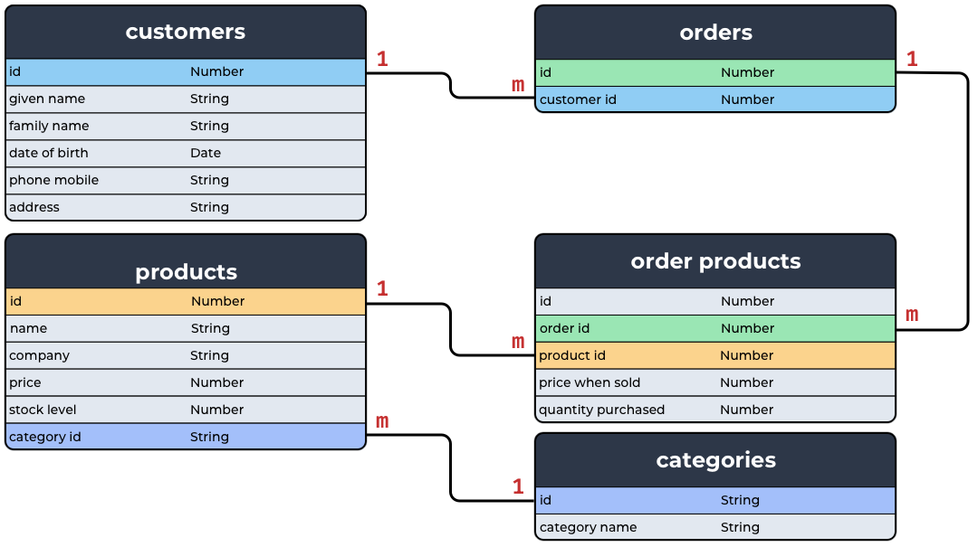
E-R Diagram for Order Database

